Slide 1

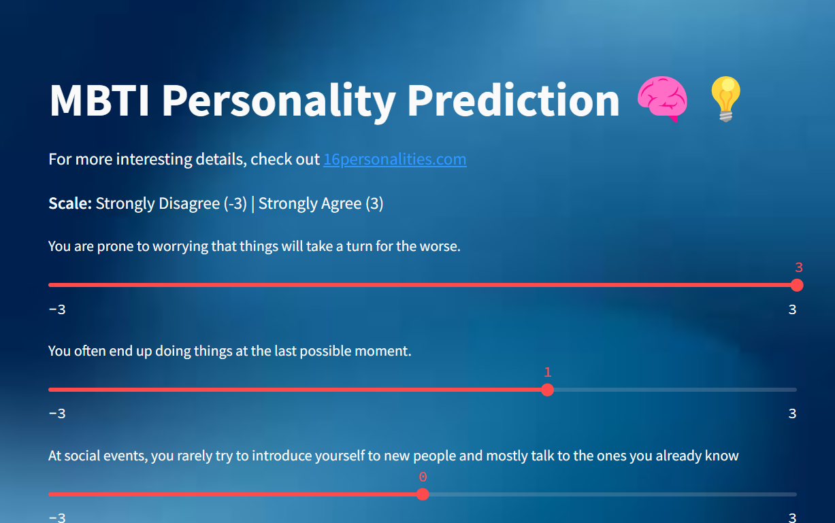


MBTI Prediction Model
Presented by
Anushka Kumar - J007
Laavanya Mishra - J035
Yatharth Desai - J075

Slide 2
Problem Statement ?
Can we accurately classify individuals into one of 16 MBTI personality types based on their responses to a set of questions using machine learning, while minimizing the number of questions required for high accuracy?

Slide 3
What is MBTI ?
MBTI (Myers-Briggs Type Indicator) is a personality classification system that categorizes people into 16 personality types based on four dichotomies:
Introversion (I) vs. Extraversion (E) – How people interact with the world.
Sensing (S) vs. Intuition (N) – How people process information.
Thinking (T) vs. Feeling (F) – How people make decisions.
Judging (J) vs. Perceiving (P) – How people approach structure and organization.
Each personality type is represented by a four-letter code (e.g., INFJ, ENFP, ESTJ). It’s widely used for self-awareness, career guidance, and team-building.

Slide 4
2. Dataset Overview
Dataset Size: 59,999 responses
Features: 61 questions (range: -3 to 3, where -3 is Strongly Disagree & 3 is Strongly Agree)
Target Variable: 16 Personality types (e.g., INFJ, ENFP)
Initial Approach: Splitting into subtypes (IE, SN, FT, PJ) resulted in poor accuracy due to classes being equally distributed.

Slide 5
Solution Approach
01
02
03
04
05
Machine Learning Model Used: Random Forest Classifier
Feature Selection: Identified the most important features(questions) to minimize redundancy
Voting Mechanism: Used multiple decision trees to improve classification reliability
Optimization: Reduced the number of questions while maintaining high accuracy
Final Accuracy: Achieved 91% accuracy after optimizing the question set

Slide 6
Why Random Forest?
Random Forest is a powerful ensemble learning method that combines multiple decision trees to improve accuracy and robustness. It is well-suited for classification tasks, especially when dealing with high-dimensional data like personality survey responses.

Slide 7
How Random Forest Works for MBTI Prediction
Random Forest is an ensemble learning method that improves classification by combining multiple decision trees. Here’s how it works for this project:
Data Splitting: The dataset (Features/Questions) is randomly split into multiple subsets.
Building Decision Trees: Each tree is trained on a different subset, considering a random selection of features (questions) at each split.
Voting Mechanism: Each tree predicts a personality type, and the final output is determined by majority voting among all trees.
Feature Importance: The model identifies which questions contribute most to the prediction, helping reduce redundant questions.

Slide 8
3. Data Preprocessing & Feature Engineering
Converted categorical personality labels into numerical classes.
Applied feature selection to reduce the number of questions while maintaining accuracy

Slide 9
4. Model Selection & Training
Model Used: Random Forest Classifier
Initial Accuracy: 97% using all questions
Reduced Questions: Improved to 91% accuracy
Feature Importance Analysis: Selected the most relevant questions for prediction

Slide 10
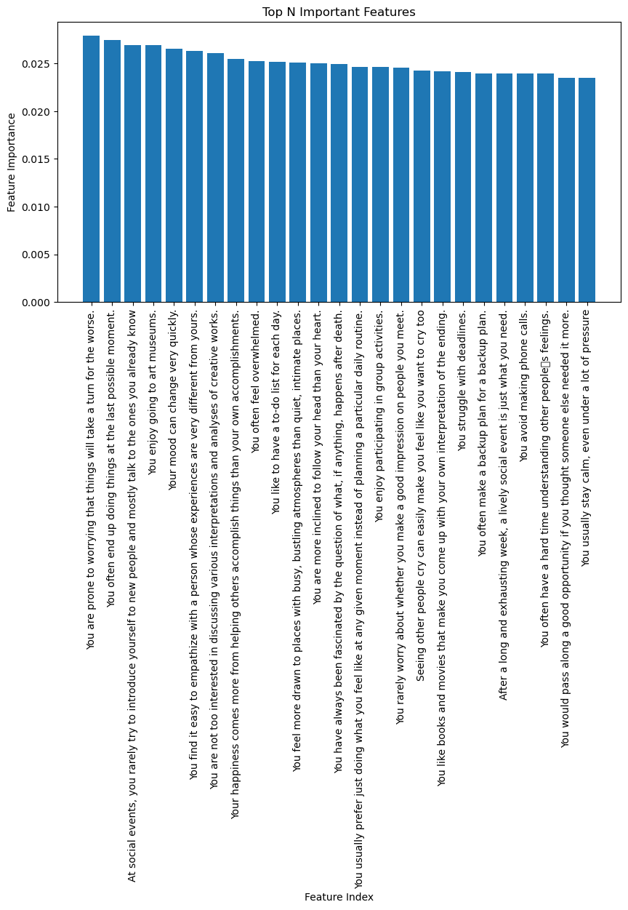

Slide 11
5. Challenges Faced
Class Overlap: Some personality types have similar traits, making classification difficult.
Feature Correlation: Many survey questions are highly correlated, leading to redundancy.
Reducing Questions Without Losing Accuracy: Finding the optimal subset of questions was complex.
Generalization Issues: The model needs to perform well on unseen data and not just the training set.
Model Complexity vs. Interpretability: Ensuring a balance between high accuracy and easy interpretability of results.

Slide 12
6. Results & Key Insights
Accuracy Improvement: Achieved 91% accuracy by optimizing the number of survey questions.
Feature Selection Efficiency: Reduced the number of questions while retaining model performance.
Random Forest Effectiveness: Performed well in handling non-linearity and feature interactions.
Balanced Dataset Impact: The model benefitted from a balanced dataset, improving classification consistency.
Interpretability: Feature importance analysis provided insights into the most influential personality traits.

Slide 13
Thank You!

